Slide 1
Resume Parser
NAME : UMA MAHESWARI
INTERNSHIP : AI Intern
BATCH NAME : MIP-AI-01

Slide 2
Abstract
With the growing demand for online recruitment, an efficient and highly accurate resume parsing method is needed. Existing resume parsing methods are basically two-stage approaches: resume segmentation and entity recognition. Some researchers apply deep learning to these two stages to improve the accuracy but at the cost of lower efficiency. In this article, we propose a multi-task deep learning model that completes resume segmentation and entity recognition at the same time, thus reducing the resume parsing time by nearly half. Moreover, our method can better parse the dual-list format resumes, which is usually ignored by other existing methods. We also use some post-correction rules to further improve the accuracy of resume parsing.

Slide 3
Introduction
In the contemporary job market, the role of technology, especially machine learning (ML) and natural language processing (NLP), in streamlining recruitment processes is becoming increasingly significant. One such area where ML and NLP are making a substantial impact is resume parsing. This blog explores the intricate world of resume parsing using ML and NLP, detailing how it's revolutionizing the way recruiters process job applications.
Resume parser with ner using state of art in deep learning with transformers specifically roberta.This project is a personal project and not ready for production use but can decently perform parsing on the resumes and extract the keywords and match it with the best possible entitites

Slide 4
Project Objective
What is Resume Parsing?
Role of Machine Learning in Resume Parsing
Integrating NLP in Resume Parsing
Practical Applications of Resume Parsing
Future of Resume Parsing: Enhancing with Advanced Models
Benefits of Intelligent Resume Parsing Software
Importance of Data for ML-Based Resume Parsing
Overcoming PDF and DOCX Conversion Challenges
Address Parsing in Resumes
The Need for Manual Tagging

Slide 5
Conc.Project Objective
Nationality Tagging in Resume Parsing
Leveraging BERT in Resume Parsing
Advanced Resume Parser Service
Model Training and Testing
Challenges
Conclusion

Slide 6
What is Resume Parsing?
At its core, resume parsing involves converting the unstructured data of resumes into a structured format. This process is pivotal in recruitment, enabling the extraction of key candidate information without manually sifting through each resume. Such automation leads to more efficient and energy-saving recruitment processes.

Slide 7
Role of Machine Learning in Resume Parsing
Machine learning has transformed resume parsing from a manual and error-prone task to an automated and accurate process. By analyzing resumes, ML models categorize them based on various parameters like skills, experience, and educational background. This categorization helps recruiters quickly identify the most suitable candidates for specific roles.

Slide 8
Integrating NLP in Resume Parsing
NLP's role in resume parsing is to understand and interpret the language used in resumes. Given that natural language is often unstructured and varies across different cultural contexts, NLP techniques are essential in extracting relevant information like skills, education, and work experience from various formatted resumes.

Slide 9
Practical Application of Resume Parsing
In practical applications, resume parsers categorize resumes into different job categories and extract crucial information like contact details, years of experience, and relevant skills. This automated summarization and categorization of resumes not only saves time but also enables recruiters to identify suitable candidates for specific roles quickly.

Slide 10
Future of Resume Parsing
Enhancing with Advanced Models
Looking ahead, the future of resume parsing involves enhancing the accuracy of these models, enabling multilingual parsing, and refining data extraction to include more entity types. The integration of advanced models like BERT in resume parsing is an exciting development, leveraging its pre-trained capabilities to further enhance parsing processes.

Slide 11
Benefits of Intelligent Resume Parsing Software
Intelligent resume parsing software offers numerous benefits. It streamlines the recruitment process by automating the parsing of thousands of resumes, thereby saving time and reducing complexity. Integration with Applicant Tracking Systems (ATS) further ensures a seamless evaluation process of job applicants, aiding recruiters in making more informed decisions.

Slide 12
Importance of data for ML-Based Resume Parsing
For ML-based resume parsing to be effective, it requires a substantial amount of data to train the algorithms accurately. The process of creating this dataset is a blend of automated techniques and manual tagging, with tools like Doccano playing a significant role in reducing the time involved in manual tagging.

Slide 13
Overcoming PDF and DOCX Conversion Challenges
One of the key challenges in resume parsing is converting PDFs and DOCX files into a text format that ML algorithms can process. Different open-source Python libraries are employed for this purpose, each having its own set of advantages and disadvantages. The final choice of the library depends on the specific requirements of the resume parsing task at hand.

Slide 14
Address Parsing in Resumes
Address parsing in resumes can be particularly challenging, especially when dealing with non-standard formats like Indian addresses. To effectively extract address information, a combination of Python libraries and custom code is used, with libraries like Pypostal offering higher accuracy.

Slide 15
Need for Manual Tagging
Despite the advancements in automated tagging, manual labeling remains a time-consuming yet crucial part of the data preparation process for ML-based resume parsing. Tools like Doccano help in creating datasets where manual tagging is necessary, ensuring the accuracy of the tagged data.

Slide 16
Nationality Tagging in Resume Parsing
Tagging nationality in resumes is a complex task due to the dual nature of terms like 'Chinese', which can refer to both a nationality and a language. Accurate nationality tagging is crucial for parsing resumes from a global talent pool.

Slide 17
Leveraging BERT in Resume Parsing
The incorporation of BERT, a pre-trained NLP model, in resume parsing, allows for leveraging the advanced NLP capabilities of the model. This inclusion has significantly improved the efficiency and accuracy of parsing resumes, enabling the extraction of detailed information such as skills, universities attended, degrees earned, and various social media links.

Slide 18
Advanced Resume Parser Service
In response to the growing need for efficient and accurate resume parsing, we are proud to introduce our advanced Resume Parser service. Utilizing the latest ML and NLP technologies, our service offers unparalleled accuracy in parsing resumes, extracting essential candidate information, and categorizing it in a structured format. Our service is designed to streamline the recruitment process, enabling recruiters to focus on the most suitable candidates quickly.

Slide 19
Model Training & Testing
Training data for an NLP project may be found in a variety of formats. SpaCy provides converters for some popular formats, such as CoNLL. In other situations, you must prepare the training data yourself.
When converting training data for use in spaCy, the main thing to remember is to create Doc objects that look exactly like the results you want as pipeline output.
We're making a file out of some NER annotations, I'm not displaying the code for that process here because it's quite lengthy; instead, I've provided a link to the code at the end of this blog you can see there.

Slide 20
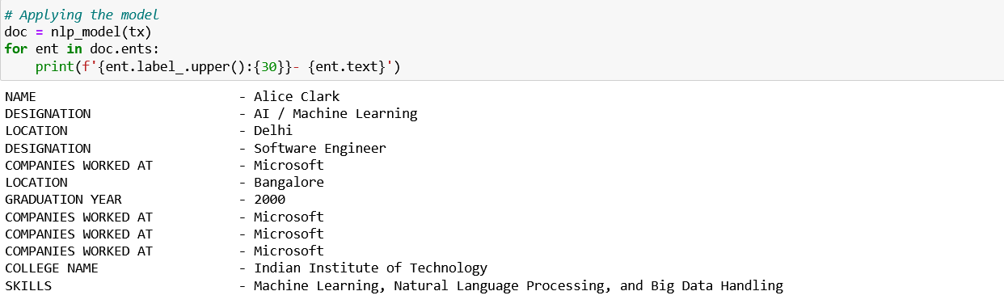
Python Program

Slide 21
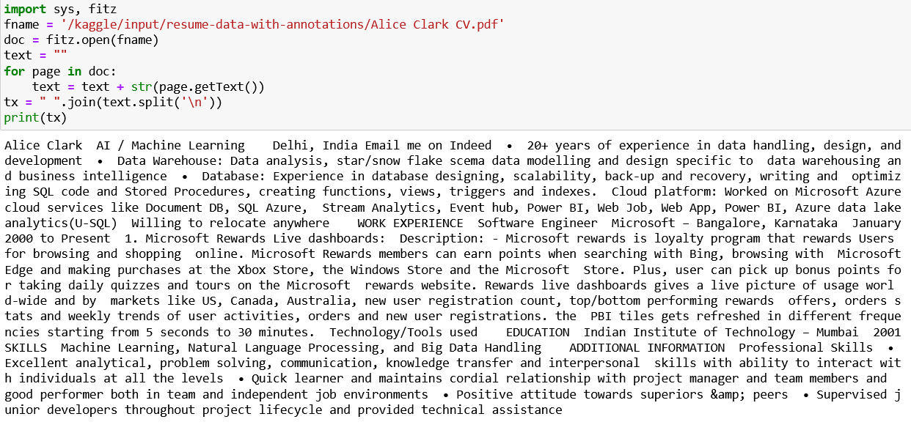

Slide 22
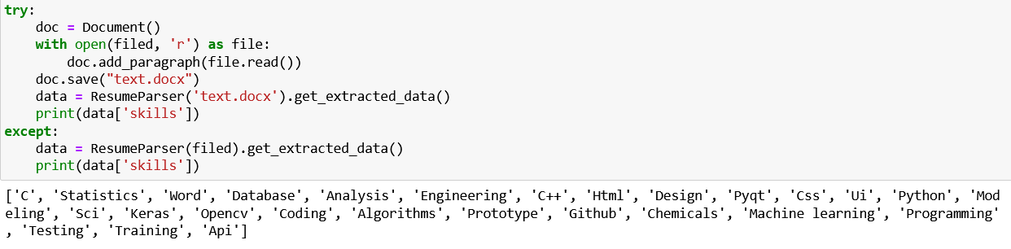

Slide 23
Challenges
It took some time for me to grasp the objective.
I did not plan ahead of time for this project. Now I’m regretting that.
I got stuck at some points while implementing, and it took awhile to find a solution.

Slide 24
Pros & Cons
Some clear and straightforward advantages
Resume parsing can save hiring managers hours spent manually reading through each resume and organizing those with relevant skills and information and eliminating those without.Using a resume parser increases your chances of finding a variety of qualified candidates who match the job descriptions of open positions at your company.
With technological advancements, we can now parse a candidate's social media page, such as their LinkedIn page, into a usable format.
There are some downsides that you’ll want to keep in mind too,When using a resume parser, it is possible to overlook a highly qualified candidate. The ideal candidate may fall through the cracks. With the “right” keywords, resume parsing can be manipulated, allowing candidates to appear to be the better fit for the job.
The integration of machine learning and natural language processing in resume parsing represents a significant advancement in the field of recruitment. This technology not only saves time and resources but also enhances the accuracy of candidate selection. As we continue to witness advancements in ML and NLP, the capabilities of resume parsing will expand further, offering more sophisticated tools for HR professionals.

Slide 25


